Slide 1

Minor Project-I on
“CASHPOINT”
(ATM SIMULATOR)
Mahakal Institute of Technology
Department of Information Technology
Presented By:
Mohammed ul baqir Salar
0704IT181012
Rudransh Solanki
0704IT181020
Saiyad M Akmal
0704IT181021
Under the guidance of: Prof. Shweta Yadav
Notes:
EMC Update
October 2004

Slide 2
Contents
Introduction
Literature Review
Problem Domain
Solution Domain
Analysis Overview
  Hardware and Software Requirement
  Functional and Non-functional Requirement
  Software model Adapted
  Use Case Diagram
  Sequence Diagram
  System flow Diagram

Slide 3
Introduction
Cashpoint (ATM Simulator) is software that gives an alternative to conventional banking and ATM system. It works similarly to the real-world ATM Machine and is completely capable of replacing it in the real world, bring reform and expedite the process. It eliminates most of the real-world problems related to the ATM system like ‘out of money’, ‘out of order’, or any other technical or physical issue. It takes similar credentials and offers almost all the facilities and even more than the ATM system. It mainly works on the idea of giving local businesses to cooperate with the bank and work as a mediator between bank and customer. These local businessmen will be the host of this software. The software is build using Java and SQL and hence is platform-independent. It is developed with all security measures keeping in mind the security and assured transaction of money with the least chance of any loophole. As an outcome dependency on Bank withdrawal counter and ATM Systems will reduce and customers will have more fast and vast options for all transactions.

Slide 4
Literature Review
STUDY OF PAYMENT BANKS
Payments bank is a new model of banking introduced by RBI in the year 2015. At that time 11 entities applied for the license to operate a payments bank including Paytm, Airtel etc. The concept of the payments bank is conceptualized by the RBI in September 2014. A team of financial advisors led by Nachiket Mor was appointed by RBI. The committee submitted a final report in which they recommended a new banking type and named it as payments banks.

Slide 5
Advantages of Payments Bank
Payments Bank has a huge advantage over any other payment method as in this payment method a customer can easily pay with just one click from his mobile phone. This does not require any complex procedure which makes it convenient for the users to pay.

Slide 6
Disadvantages of Payments Bank
The payments bank is not a traditional bank and it is its advantage as well as its disadvantage. Disadvantage because we cannot opt for credit cards as well as a loan from this bank. We only can pay and receive digital money so it is only used for transferring money from one wallet to another.
Most of the transactions that people prefer today are cash based, so in this case cashless system is a big problem.

Slide 7
Problem Domain
Financial activities need to be strong, strict and secure. But still somewhere there remains some flaw in the system flow. ATM System has many technical and physical problems. Most of the time they are not even present in all the places to facilitate the customers. Limitation of the number of ATMs or the amount of money available in them creates problems. Most of the time it says ‘out of money’, ‘out of order’ or even sometimes there is no ATM nearby. Sometimes the amount is withdrawn from the customer account but the money does not dispense the cash. ATMs also have physical problems such as worn-out ATM cards, broken keypad, or receipt malfunctions.
The lack of ATM is the first and biggest problem.

Slide 8
Solution Domain
This application attempts to solve most of the real-world problems associated with the ATM system. It mainly works on the idea of giving local businesses to cooperate with the bank and work as a mediator between bank and customer. This application can be hosted by any small vendor to a big businessman who can afford to provide this service. The owner/admin/host will give the withdraw amount of the customer and also receive the deposit from the customer and the same activities will be recorded on the bank server. The application keeps a double record of the transactions and also keeps in mind the limitations and provisions to be given to the host. Hence the number of ‘Cashpoint’ will be more and dependency on the bank withdrawal counter and ATMs will reduce. The chances of withdraw fails will be minimum and to the most extent, no chance. Since the host himself will confirm and give the money in hand. Withdraw amount of the customer is actually the amount given by the host and the deposit amount is actually the amount received by the host, and each and every step and transaction is recorded and saved so security and assurity of the software are firm and high.

Slide 9
Hardware and Software requirements
To be used efficiently, all computer software needs certain hardware components or other software resources to be present on a computer.
Our application demands some hardware requirements which include, Minimum 1 Giga Bytes of RAM. This software is developed on java so the system requires a java runtime environment to run the software. Since java is platform independent the application will work on all the operating systems which have JRE 8 or higher. Hardware requirements include a computer system with keyboard, screen and printer; and internet connectivity in case of mobile database access.
The above hardware requirements will be enough to run this application on anyone’s mobile phone.

Slide 10
Functional and Non-Functional requirements
The software focuses on the finance domain and the banking system. It is made ready to be used in the real-world as an alternative to ATM. If the proposed system is applied precisely, it will bring reform in the banking and finance system and will have a great impact making the transfer of money much easy and fast. Small villages or towns which have fewer ATMs available or face the problem of lack of money will get a huge advantage from this system. At present, no such system is in use
The main functional requirement of the project is in fulfilling the huge requirement of cash availability in most of the areas of countries where cashless transaction is still not adopted. Additionally, it will also ease the transactions with bank and reduce the dependency over atm systems and bank withdrawal or deposit counters.
It provides all the functionalities that an ATM system provides, from withdrawal to deposit, checking mini-statement and even change pin. With full security and least chances of any failure.
It provides separate administrative services for the host which includes checking history, checking history of a particular card holder and calculate the net total from the amount host gave as withdrawal to the customer and received as deposit.

Slide 11

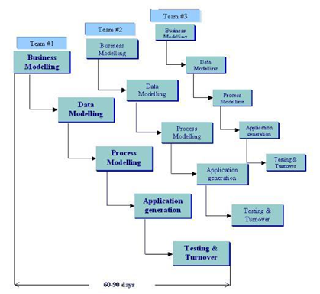
Software model Adapted

Slide 12
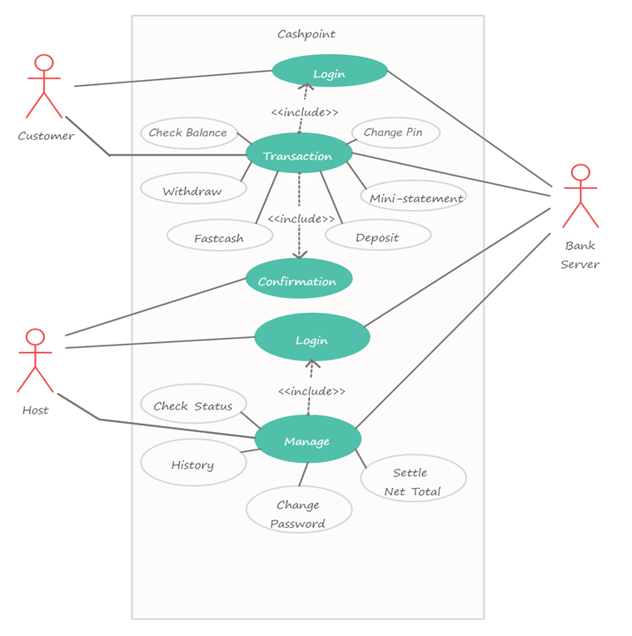
Use Case Diagram

Slide 13
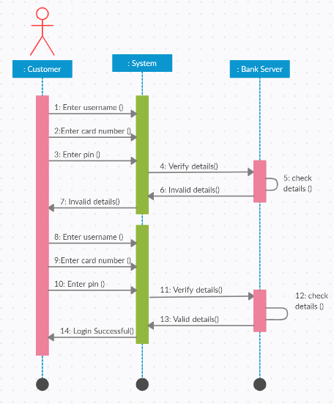
Sequence Diagram

Slide 14
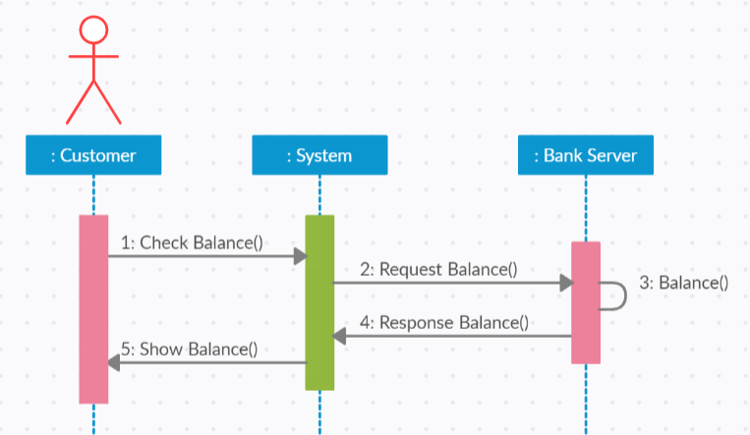


Slide 15
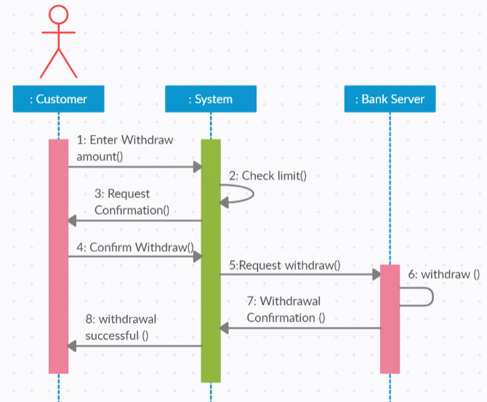

Slide 16
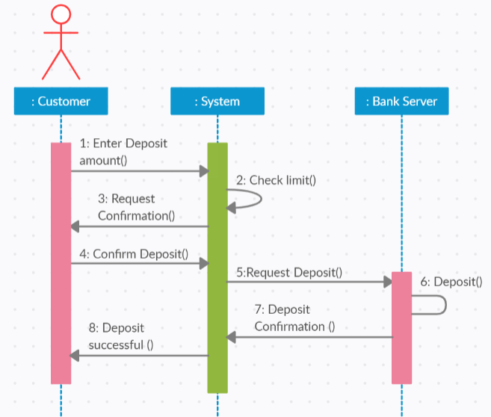

Slide 17
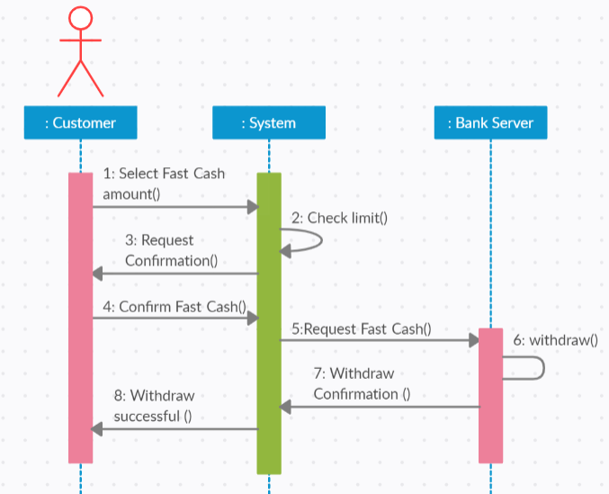

Slide 18
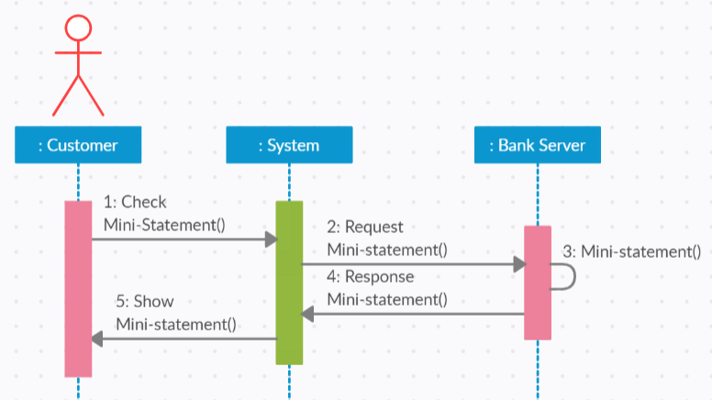

Slide 19
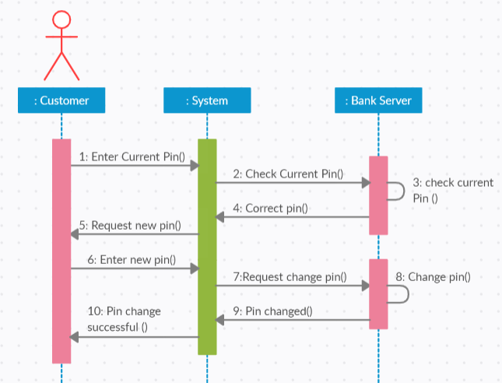

Slide 20
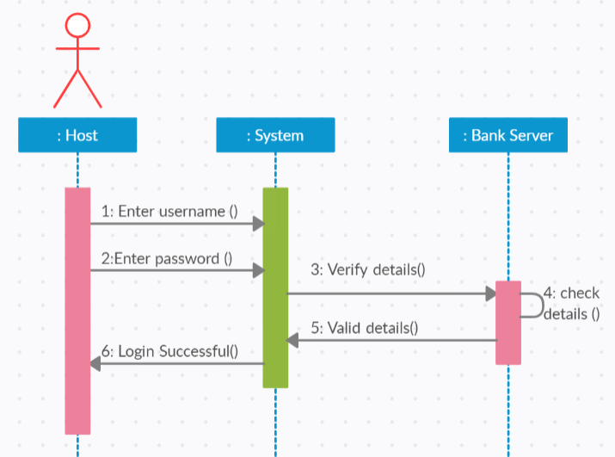

Slide 21
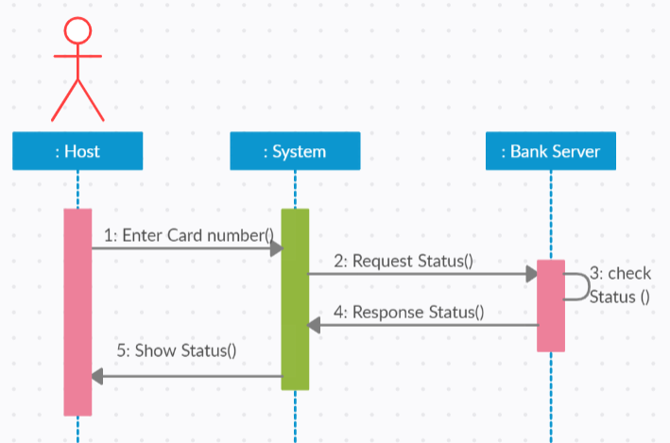

Slide 22
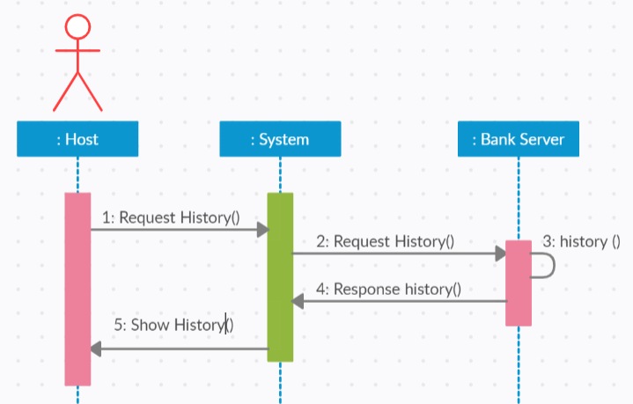

Slide 23
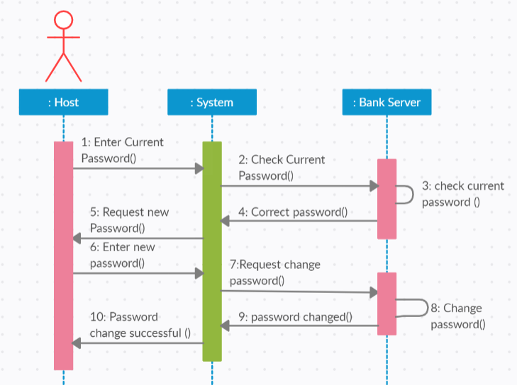

Slide 24
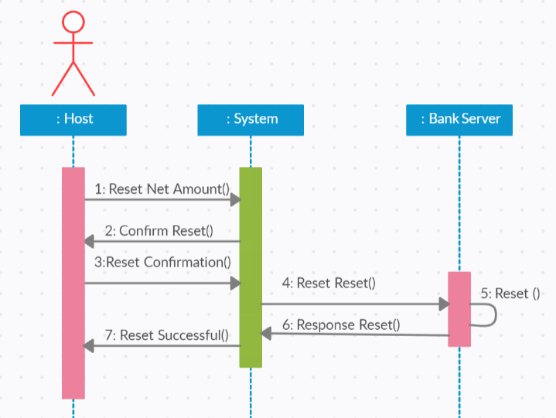

Slide 25
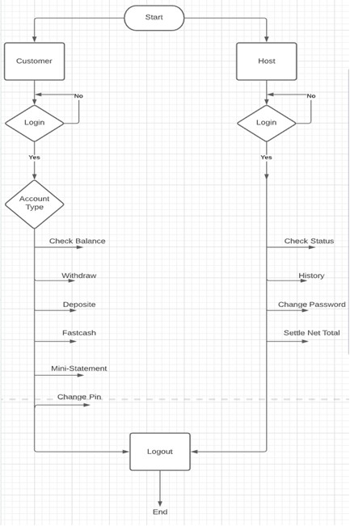
System flow Diagram

Slide 26

Any Query ?

Slide 27



